Slide 1
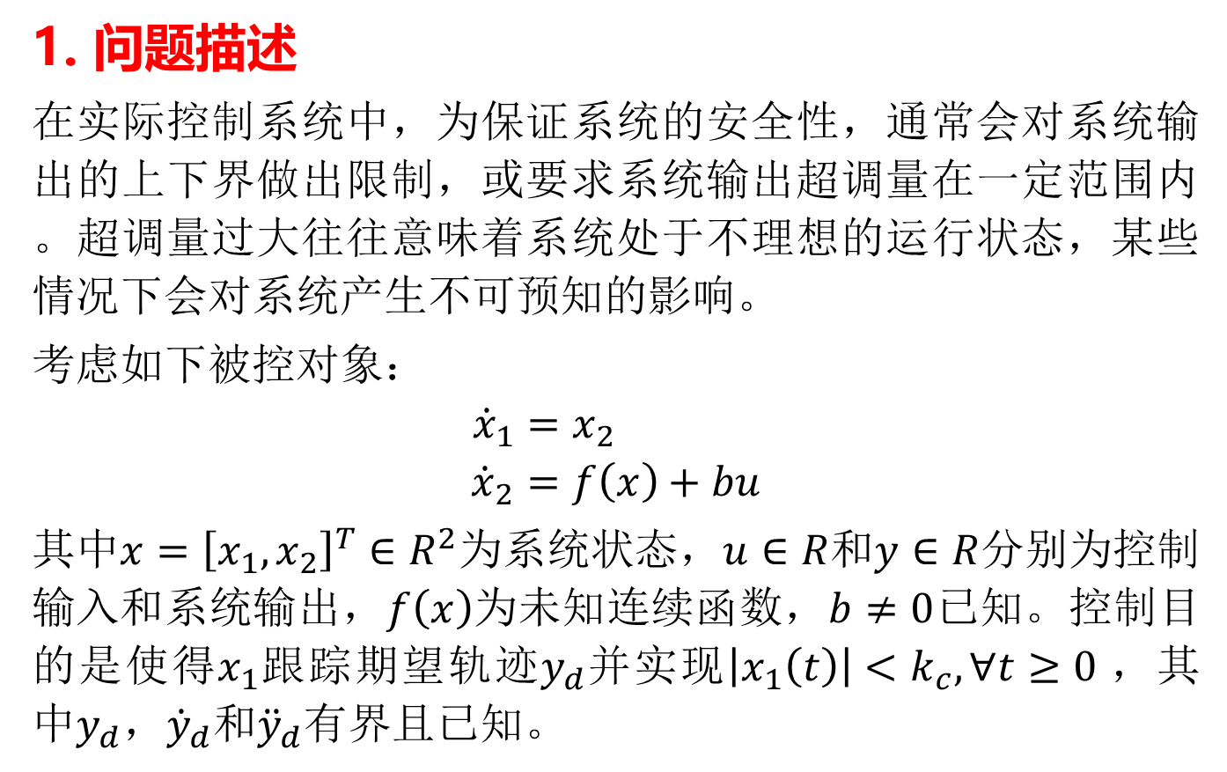
1. 问题描述
在实际控制系统中，为保证系统的安全性，通常会对系统输出的上下界做出限制，或要求系统输出超调量在一定范围内。超调量过大往往意味着系统处于不理想的运行状态，某些情况下会对系统产生不可预知的影响。
考虑如下被控对象：
$${\dot{x}}_{1}=x_{2}$$
$${\dot{x}}_{2}=f\left(x\right)+bu$$
其中$x={\left[x_{1},x_{2}\right]}^{T}∈R^{2}为系统状态，u∈R$和$y∈R$分别为控制输入和系统输出，$f\left(x\right)$为未知连续函数，$b≠0$已知。控制目的是使得$x_{1}$跟踪期望轨迹$y_{d}并$实现$\left|x_{1}\left(t\right)\right|<k_{c},∀t≥0$，其中$y_{d}，{\dot{y}}_{d}$和${\ddot{y}}_{d}$有界且已知。

Slide 2

引理1: 对于$k_{b}>0和\left|z\right|<k_{b},$有
$$\ln{\frac{k_{b}^{2}}{k_{b}^{2}−z_{}^{2}}}<\frac{z_{}^{2}}{k_{b}^{2}−z_{}^{2}}$$
图1 障碍Lyapunov函数

Slide 3
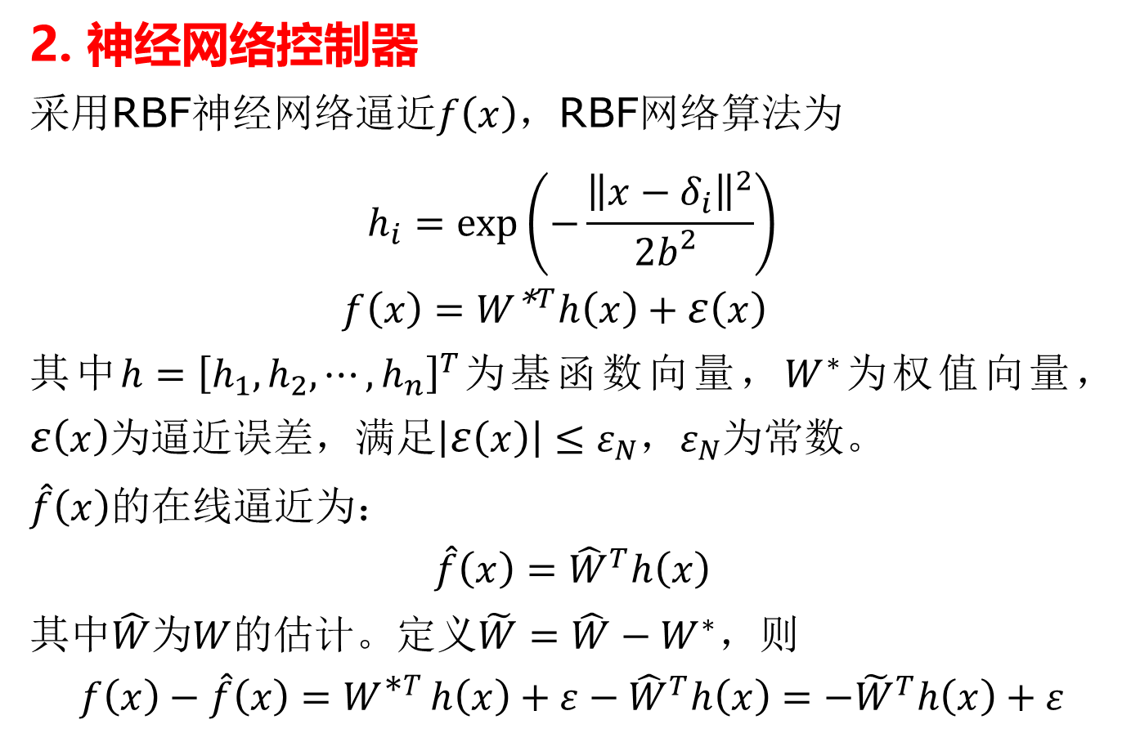
2. 神经网络控制器
采用RBF神经网络逼近$f\left(x\right)$，RBF网络算法为
$$h_{i}=\exp\left(−\frac{{\left\|x−δ_{i}\right\|}^{2}}{2b_{}^{2}}\right)$$
$$f\left(x\right)=W^{\text{∗}T}h\left(x\right)+ε\left(x\right)$$
其中$h={\left[h_{1},h_{2},⋯,h_{n}\right]}^{T}$为基函数向量，$W^{∗}$为权值向量，$ε\left(x\right)$为逼近误差，满足$\left|ε\left(x\right)\right|≤ε_{N}$，$ε_{N}$为常数。
$\hat{f}\left(x\right)$的在线逼近为：
$$\hat{f}\left(x\right)={\hat{W}}^{T}h\left(x\right)$$
其中$\hat{W}$为$W$的估计。定义$\tilde{W}=\hat{W}−W^{∗}$，则
$$f\left(x\right)−\hat{f}\left(x\right)=W^{\text{∗}T}h\left(x\right)+ε−{\hat{W}}^{T}h\left(x\right)=−{\tilde{W}}^{T}h\left(x\right)+ε$$

Slide 4
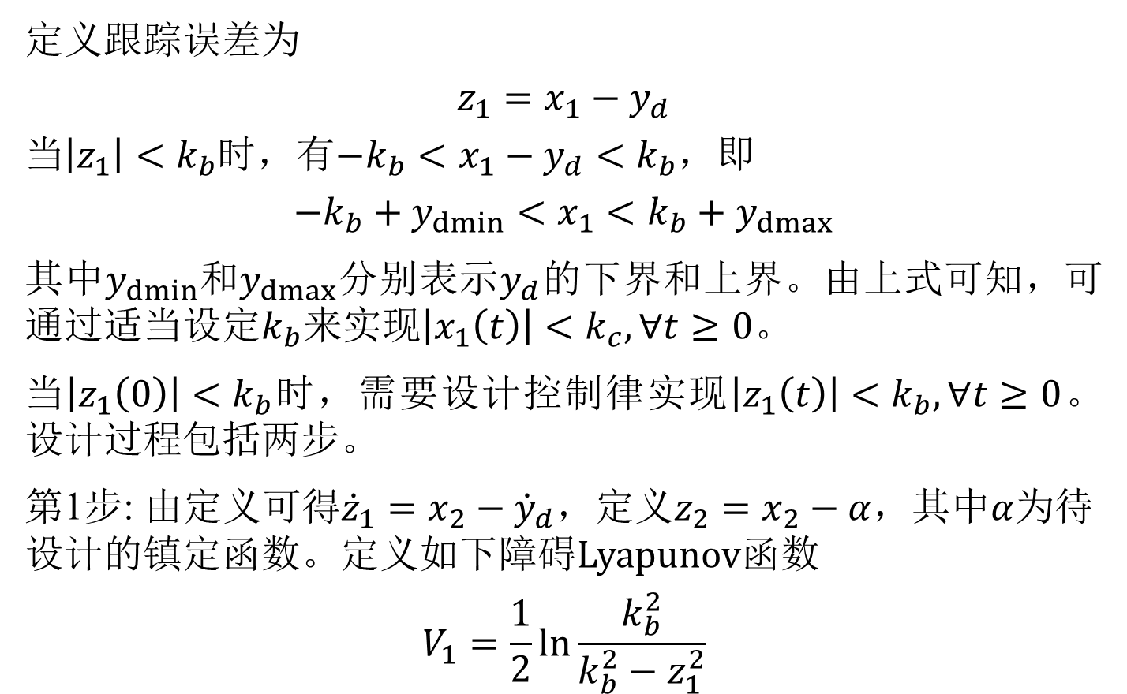
定义跟踪误差为
$$z_{1}=x_{1}−y_{d}$$
当$\left|z_{1}\right|<k_{b}$时，有$−k_{b}<x_{1}−y_{d}<k_{b}$，即
$$−k_{b}+y_{dmin}<x_{1}<k_{b}+y_{dmax}$$
其中$y_{dmin}$和$y_{dmax}$分别表示$y_{d}$的下界和上界。由上式可知，可通过适当$设定k_{b}来$实现$\left|x_{1}\left(t\right)\right|<k_{c},∀t≥0$。
当$\left|z_{1}\left(0\right)\right|<k_{b}$时，需要设计控制律实现$\left|z_{1}\left(t\right)\right|<k_{b},∀t≥0$。设计过程包括两步。
第1步: 由定义可得${\dot{z}}_{1}=x_{2}−{\dot{y}}_{d}$，定义$z_{2}=x_{2}−α$，其中$α$为待设计的镇定函数。定义如下障碍Lyapunov函数
$$V_{1}=\frac{1}{2}\ln{\frac{k_{b}^{2}}{k_{b}^{2}−z_{1}^{2}}}$$

Slide 5
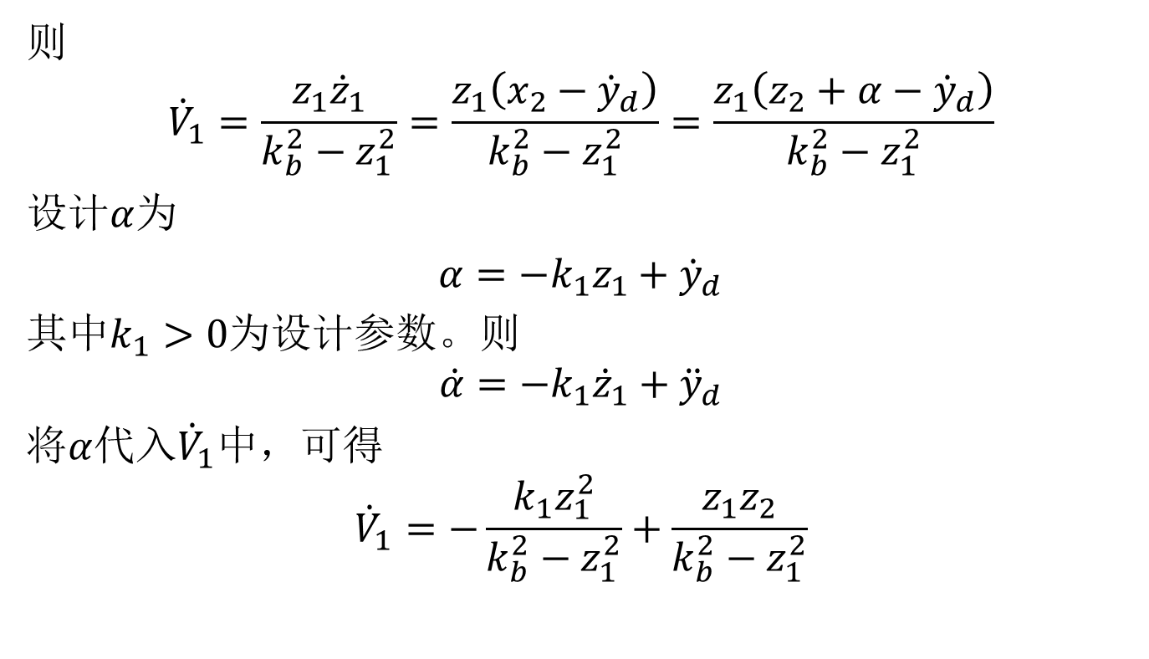
则
$${\dot{V}}_{1}=\frac{z_{1}{\dot{z}}_{1}}{k_{b}^{2}−z_{1}^{2}}=\frac{z_{1}\left(x_{2}−{\dot{y}}_{d}\right)}{k_{b}^{2}−z_{1}^{2}}=\frac{z_{1}\left(z_{2}+α−{\dot{y}}_{d}\right)}{k_{b}^{2}−z_{1}^{2}}$$
设计$α$为
$α=−k_{1}z_{1}+{\dot{y}}_{d}$
其中$k_{1}>0$为设计参数。则
$$\dot{α}=−k_{1}{\dot{z}}_{1}+{\ddot{y}}_{d}$$
将$α$代入${\dot{V}}_{1}$中，可得
$${\dot{V}}_{1}=−\frac{k_{1}z_{1}^{2}}{k_{b}^{2}−z_{1}^{2}}+\frac{z_{1}z_{2}}{k_{b}^{2}−z_{1}^{2}}$$

Slide 6
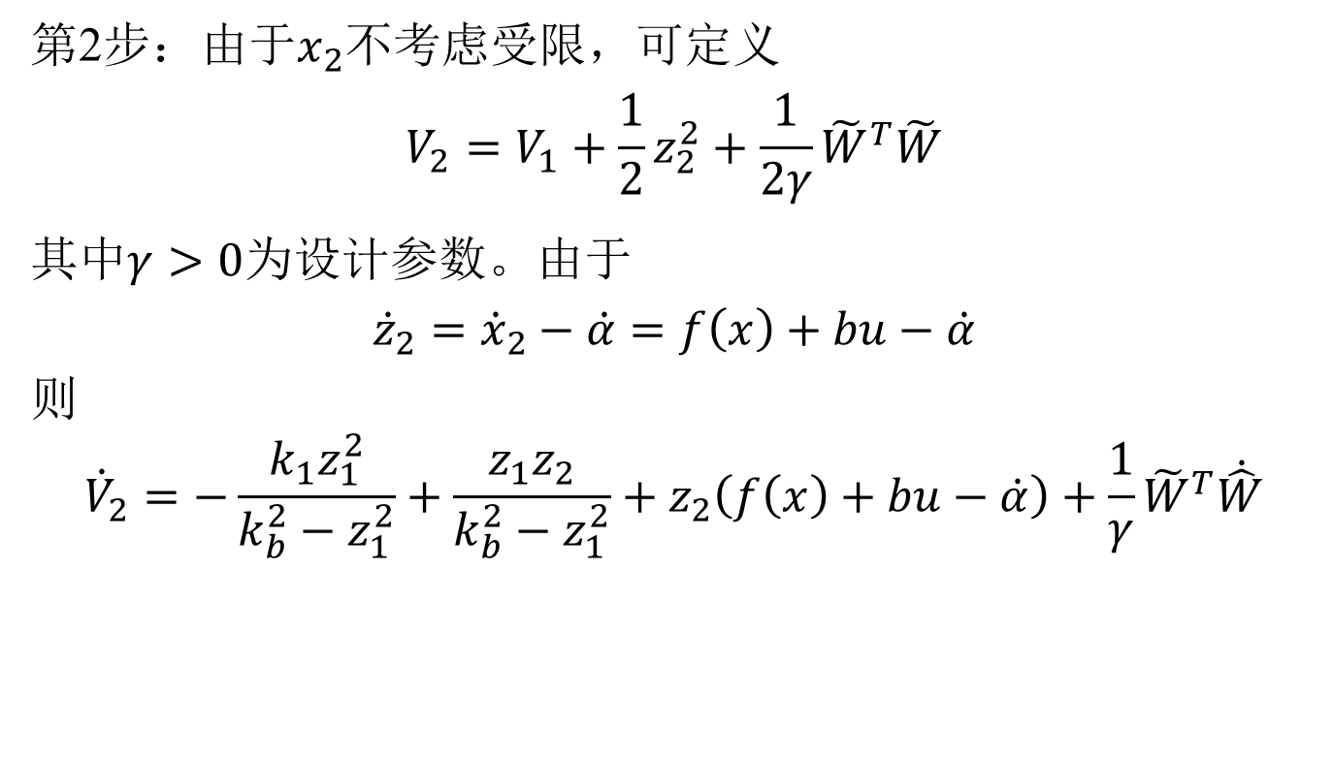
第2步：由于$x_{2}$不考虑受限，可定义
$$V_{2}=V_{1}+\frac{1}{2}z_{2}^{2}+\frac{1}{2γ}{\tilde{W}}^{T}\tilde{W}$$
其中$γ>0$为设计参数。由于
$${\dot{z}}_{2}={\dot{x}}_{2}−\dot{α}=f\left(x\right)+bu−\dot{α}$$
则
$${\dot{V}}_{2}=−\frac{k_{1}z_{1}^{2}}{k_{b}^{2}−z_{1}^{2}}+\frac{z_{1}z_{2}}{k_{b}^{2}−z_{1}^{2}}+z_{2}\left(f\left(x\right)+bu−\dot{α}\right)+\frac{1}{γ}{\tilde{W}}^{T}\dot{\hat{W}}$$

Slide 7
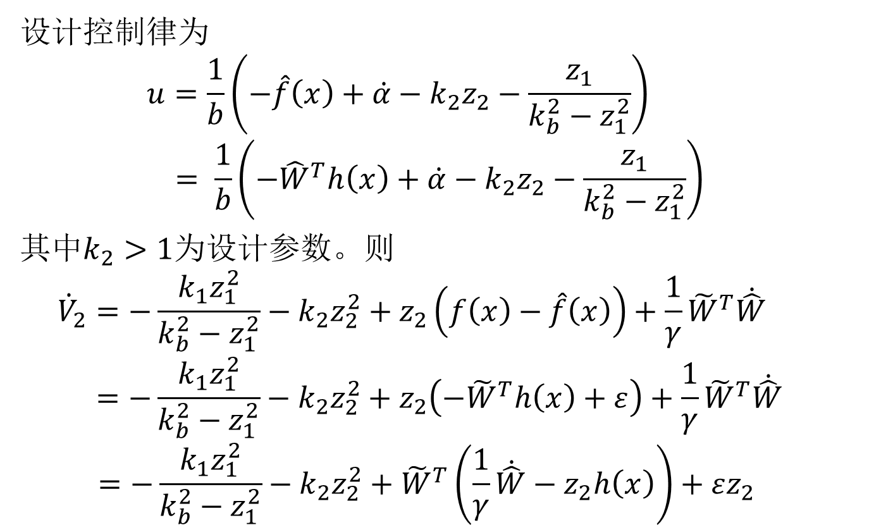
设计控制律为
$$u=\frac{1}{b}\left(−\hat{f}\left(x\right)+\dot{α}−k_{2}z_{2}−\frac{z_{1}}{k_{b}^{2}−z_{1}^{2}}\right)$$
$$= \frac{1}{b}\left(−{\hat{W}}^{T}h\left(x\right)+\dot{α}−k_{2}z_{2}−\frac{z_{1}}{k_{b}^{2}−z_{1}^{2}}\right)$$
其中$k_{2}>1$为设计参数。则
$${\dot{V}}_{2}=−\frac{k_{1}z_{1}^{2}}{k_{b}^{2}−z_{1}^{2}}−k_{2}z_{2}^{2}+z_{2}\left(f\left(x\right)−\hat{f}\left(x\right)\right)+\frac{1}{γ}{\tilde{W}}^{T}\dot{\hat{W}}$$
$$=−\frac{k_{1}z_{1}^{2}}{k_{b}^{2}−z_{1}^{2}}−k_{2}z_{2}^{2}+z_{2}\left(−{\tilde{W}}^{T}h\left(x\right)+ε\right)+\frac{1}{γ}{\tilde{W}}^{T}\dot{\hat{W}} \\ =−\frac{k_{1}z_{1}^{2}}{k_{b}^{2}−z_{1}^{2}}−k_{2}z_{2}^{2}+{\tilde{W}}^{T}\left(\frac{1}{γ}\dot{\hat{W}}−z_{2}h\left(x\right)\right)+εz_{2}$$

Slide 8
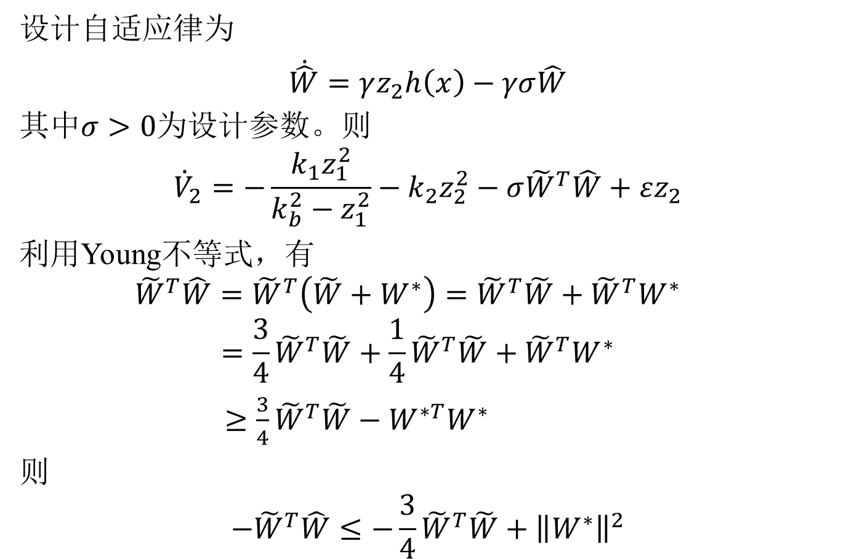
设计自适应律为
$\dot{\hat{W}}=γz_{2}h\left(x\right)−γσ\hat{W}$
其中$σ>0$为设计参数。则
$${\dot{V}}_{2}=−\frac{k_{1}z_{1}^{2}}{k_{b}^{2}−z_{1}^{2}}−k_{2}z_{2}^{2}−{σ\tilde{W}}^{T}\hat{W}+εz_{2}$$
利用Young不等式，有
$${\tilde{W}}^{T}\hat{W}={\tilde{W}}^{T}\left(\tilde{W}+W^{∗}\right)={\tilde{W}}^{T}\tilde{W}+{\tilde{W}}^{T}W^{∗}$$
$$=\frac{3}{4}{\tilde{W}}^{T}\tilde{W}+\frac{1}{4}{\tilde{W}}^{T}\tilde{W}+{\tilde{W}}^{T}W^{∗}$$
$≥\frac{3}{4}{\tilde{W}}^{T}\tilde{W}−W^{∗T}W^{∗}$
则
$$−{\tilde{W}}^{T}\hat{W}≤−\frac{3}{4}{\tilde{W}}^{T}\tilde{W}+{\left\|W^{∗}\right\|}^{2}$$

Slide 9

根据引理1，有
$$−\frac{k_{1}z_{1}^{2}}{k_{b}^{2}−z_{1}^{2}}<−k_{1}\ln{\frac{k_{b}^{2}}{k_{b}^{2}−z_{1}^{2}}}$$
此外，
$$εz_{2}≤\frac{1}{4}ε_{N}^{2}+z_{2}^{2}$$
从而有
$${\dot{V}}_{2}≤−k_{1}\ln{\frac{k_{b}^{2}}{k_{b}^{2}−z_{1}^{2}}}−\left(k_{2}−1\right)z_{2}^{2}−\frac{3}{4}{σ\tilde{W}}^{T}\tilde{W}$$
$$+σ{\left\|W^{∗}\right\|}^{2}+\frac{1}{4}ε_{N}^{2}$$

Slide 10
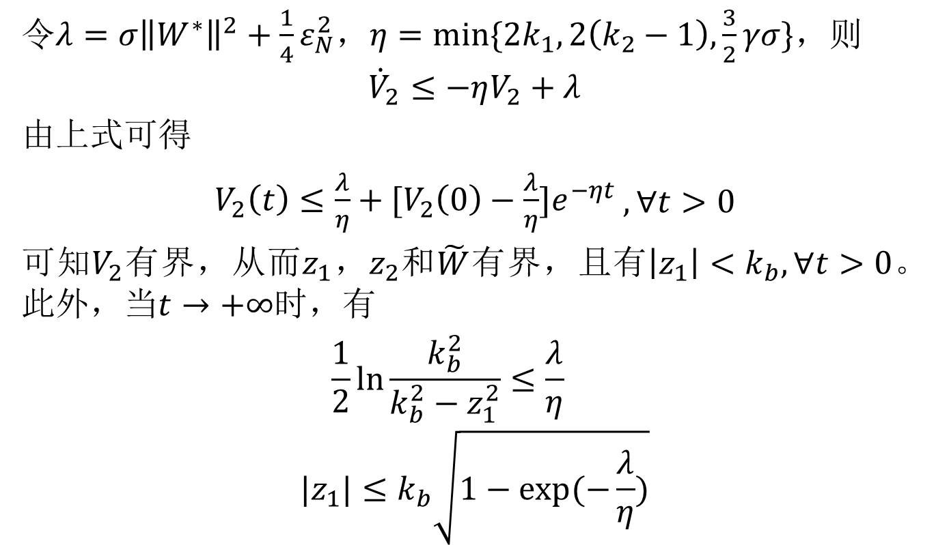
令$λ={σ\left\|W^{∗}\right\|}^{2}+\frac{1}{4}ε_{N}^{2}$，$η=\min{\{2k_{1},2\left(k_{2}−1\right),\frac{3}{2}γσ\}}$，则
$${\dot{V}}_{2}≤−ηV_{2}+λ$$
由上式可得
$V_{2}\left(t\right)≤{\frac{λ}{η}+[V_{2}\left(0\right)−\frac{λ}{η}]e}^{−ηt}$ $,∀t>0$
可知$V_{2}$有界，从而$z_{1}$，$z_{2}$和$\tilde{W}$有界，且有$\left|z_{1}\right|<k_{b},∀t>0$。此外，当$t→+∞$时，有
$$\frac{1}{2}\ln{\frac{k_{b}^{2}}{k_{b}^{2}−z_{1}^{2}}}≤{\frac{λ}{η}}^{}$$
$$|z_{1}|≤k_{b}\sqrt{1−exp⁡(−\frac{λ}{η})}$$

Slide 11
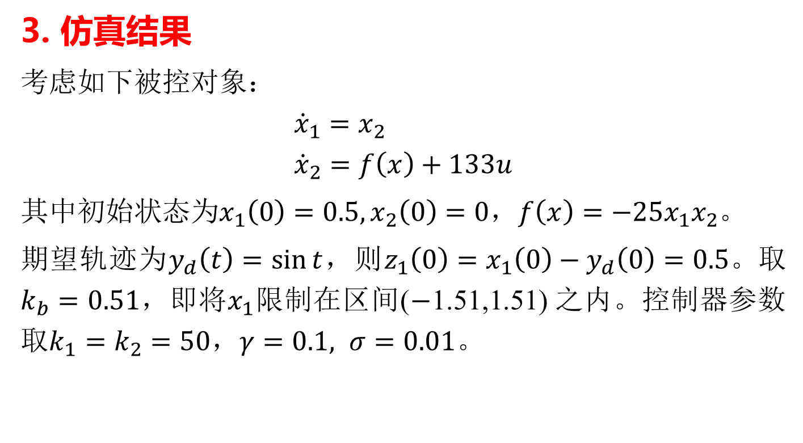
3. 仿真结果
考虑如下被控对象：
$${\dot{x}}_{1}=x_{2} \\ {\dot{x}}_{2}=f\left(x\right)+133u$$
其中初始状态为$x_{1}\left(0\right)=0.5,x_{2}\left(0\right)=0$，$f\left(x\right)=−25x_{1}x_{2}$。
期望轨迹为$y_{d}\left(t\right)=\sin{t}$，则$z_{1}\left(0\right)=x_{1}\left(0\right)−y_{d}\left(0\right)=0.5。取k_{b}=0.51$，即将$x_{1}$限制在区间($−$1.51,1.51) 之内。控制器参数取$k_{1}=k_{2}=50$，$γ=0.1, σ=0.01$。

Slide 12
图2 跟踪效果

Slide 13
图3 控制输入

Slide 14

图4 $z_{1}$的轨迹

